Slide 1
Human Computer Interaction Week 12: Modern UI by Henrik Lange

Slide 2

Plan
Week 1: Setting The Stage
Week 2: Mapping, Personas and Journeys
Week 3: Sketching
Week 4: Decisions and Storyboards
Week 5: Prototyping
Week 6: Prototype Testing
Week 7: Graphic Design
Week 8: Building Modern UI (CSS)
Week 9: Building Modern UI (Bootstrap, jQuery & Leaflet)
Week 10: Accessibility and SEO
Week 11: Usability Testing
Week 12: Building Modern UI

Slide 3
Agenda
Last Week – Catch Up
Modern UI
MVC
View Engines
Coupling and cohesion
Composite UI
Single Page Applications
Angular
Selecting Technologies
Exam Questions

Slide 4
Last Week

Slide 5
Usability Test
How did your tests go?
Did you learn something new?
What’s the difference between a user test and a usability test?

Slide 6
This Week: Modern UI

Slide 7
Software Development
High cohesion, low coupling
Avoid duplicate code
Write reusable code
Are these only backend principles?

Slide 8
MVC
Client
Router
Model-View-Controller
The client calls the controller
The controller gets the data from the model
The controller sends the data to the view
The controller sends the populated view to the client
Service
Controller
View
Model
Partial View
DB

Slide 9







MVC
Client
Router
Model-View-Controller
The client calls the controller
The controller gets the data from the model
The controller sends the data to the view
The controller sends the populated view to the client
Service
Controller
View
Model
Partial View
DB

Slide 10

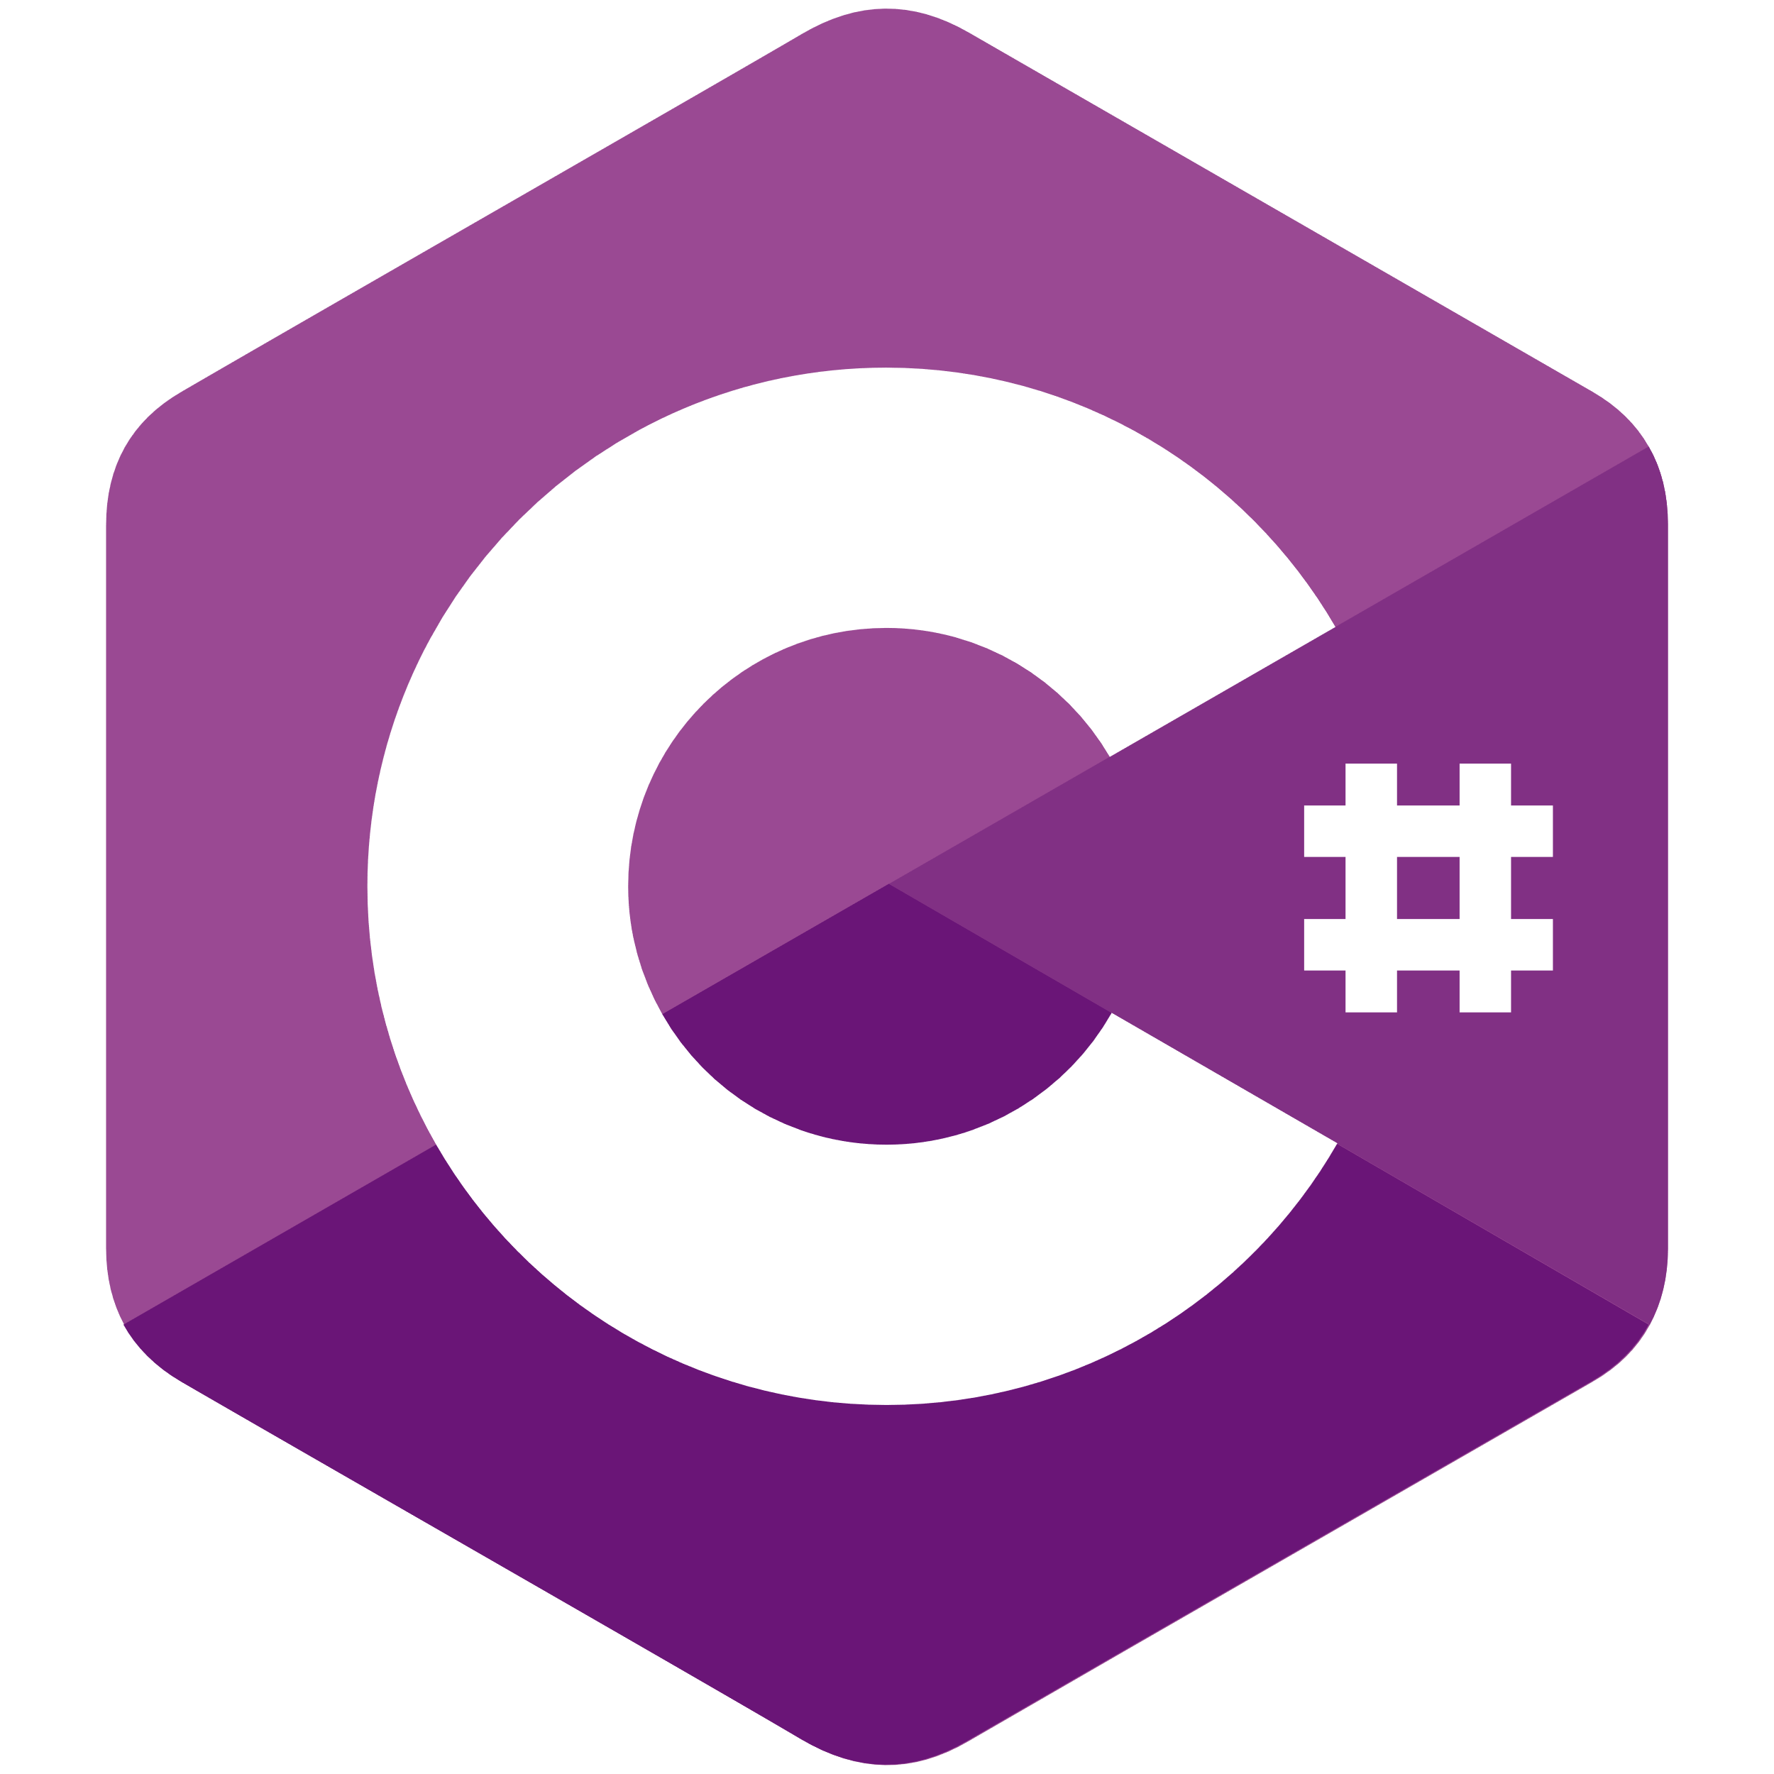
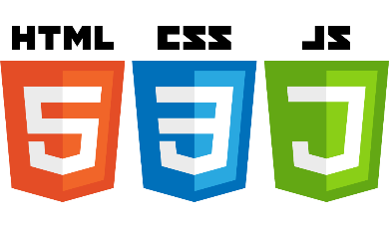


MVC
Client
Router
Model-View-Controller
The client calls the controller
The controller gets the data from the model
The controller sends the data to the view
The controller sends the populated view to the client
Can anyone spot the issue with this approach?
I will take your guesses, but the answer will come later
Service
Controller
View
Model
Partial View
DB

Slide 11
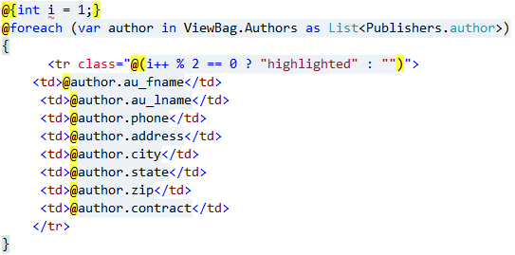
View Engines
Razor syntax
There are equivalents for other languages
C#: Razor
Java: Java Server Pages (JSP)
PHP default
2 separate approaches:
Create a content view and import header and footer
Create a standard site with header and footer and import the required content view

Slide 12
Low Coupling, High Cohesion
Ask yourself these questions during development
How many modules am I touching to fix this or create this functionality?
How many different places does this change need to take place?
How hard is it to test my code?
Can we improve this by making code more loosely coupled? Can this be improved by making our code more cohesive?
Separation of concerns in packages, classes and methods/functions
This makes code reusable code
Every time you import a library, that is reusable code someone wrote
Every time you reuse code from another project, you save money

Slide 13
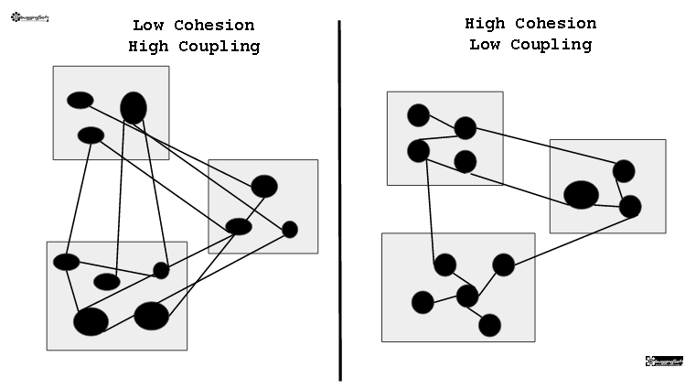
Low Coupling, High Cohesion
You learned the 3-layer model
Presentation, business and data layers
Much like MVC
Each layer is best separated if one or few classes facilitate cross-layer communication
Single-responsibility classes and separation of concerns
https://naiwaen.debuggingsoft.com/2014/07/cohesion-vs-coupling/

Slide 14
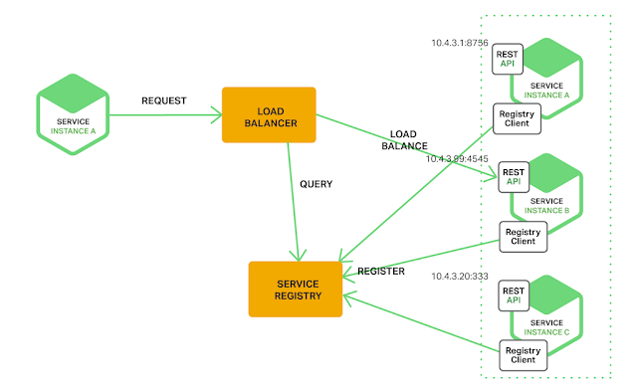
Component Based Software Development
Service Discovery
Imagine a Java application that never uses the keyword ”new”
Each class is only concerned with its own functionality or data
If it is dependent on an instance of another class, then that instance will be required in the constructor
The Service Registry will make keep current objects in memory and use them in constructors or create new ones as needed
Spring Boot for Java does this
https://dzone.com/articles/spring-cloud-netflix-how-works-service-registratio

Slide 15
MVC
Client
Router
Let’s clean it up a bit…
Service
Controller
View
Model
Partial View
DB

Slide 16
MVC
Where do we place an API?
API consumption is typically in a service
There is no consensus on placement of API expotion
Service
Controller
View
API??
Model
My site wants to use your API

Slide 17
MVC
Where do we place an API?
API consumption is typically in a service
There is no consensus on placement of API expotion
But it is definitely not in a view
For the sake of conversation, let’s say it’s in the controller
Service
Controller
View
Model
My site wants to use your API

Slide 18
MVC
API
Browser
Now, a browser can use the application with a view and the API can use the application without a view!
What is the problem?
Service
Controller
View
Model

Slide 19
MVC
API
Browser
Now, a browser can use the application with a view and the API can use the application without a view!
What is the problem?
Separation of concerns!
The controller must now compose both views and API data/functionality
What is the solution?
Service
Controller
View
Model

Slide 20
Composite UI
Browser
View
API
Now, a browser can use the application with a view and the API can use the application without a view!
What is the problem?
Separation of concerns!
The controller must now compose both views and API data/functionality
What is the solution?
Now, the browser looks at a view, and that view just uses the API
It needs the same data anyway!
And the controller only has to be concerned with exposing an API
Service
Controller
Model

Slide 21
Composite UI
Browser
View
API
How do we do that?
What about partial views?
What about View Engines?
Service
Controller
Model

Slide 22
Object Relation Mapper
Browser
View
API
How similar are object oriented classes to their database table counterparts?
When you made 3-layer model projects, how much of your data layer was represented in the database?
Consider the UML and ER diagrams if that is easier to remember
An object relation mapper or ORM is a piece of code that maps your database to your data objects (MVC Models)
By using ORM’s, we effectively avoid SQL in our backend code
a java application stays Java – not SQL (using e.g. Hibernate)
A C# application stays C# - not SQL (using Entity Framework and LINQ)
Service
Controller
Model
DB
ORM

Slide 23
View Engines
API
Browser
Primary purpose is to mix backend and frontend languages
How well does this play into separation of concerns? Low coupling?
Should the backend programmers write the backend part of the view engine code then?
Or should the frontend developers learn backend code?
ORMs separated Database specialists from the application logic. They don’t need backend code, and backend coders don’t need SQL.
Service
Controller
View
Model
DB
ORM

Slide 24

Composite UI
Browser
View
API
By composing the UI, we no longer have any backend language in it
And the backend code has no concern for the contents or composition of the frontend
We can now separate the application having just one programming language in each file we write
Browsers only understand HTML, CSS and JS, so there is no reason frontend developers should be concerned with anything else
Service
Controller
Model
DB
ORM

Slide 25
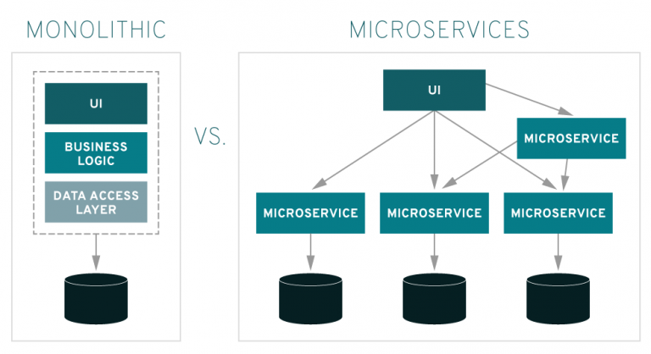
Composite UI & Microservices
JavaScript supports dependency injection
Dependency injection is what allows for Unit Testing
Mocking and configuration can be done with JS
JSON is a native JS component
By removing the UI from the monolith, we are free to restructure the backend and work with as many microservices as we want to
Interdependencies can be managed via API’s
https://pretius.com/why-you-should-choose-the-microservices-architecture/

Slide 26
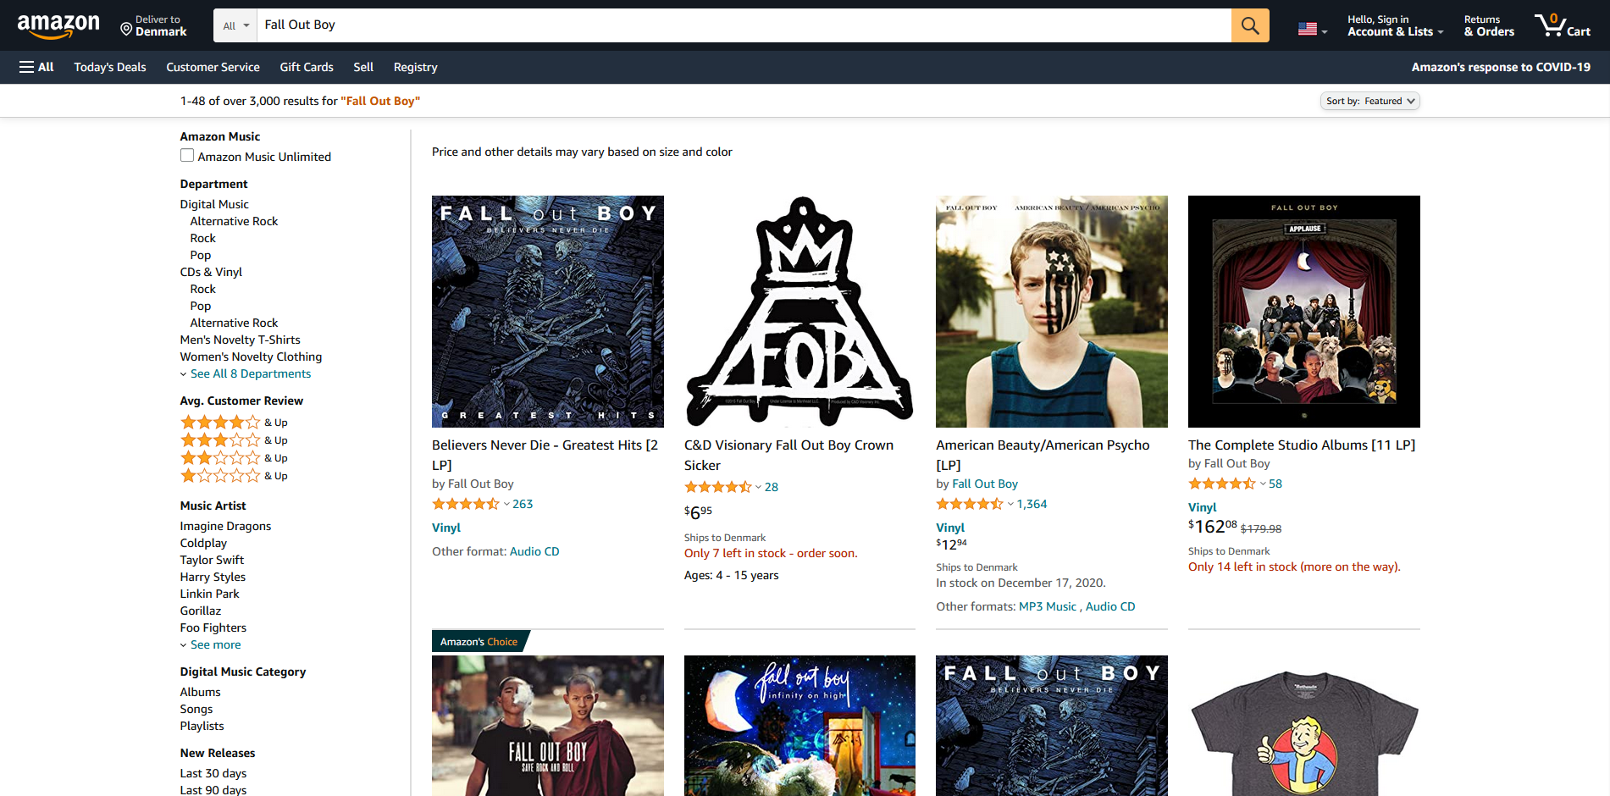
How many microservices are called?

Slide 27
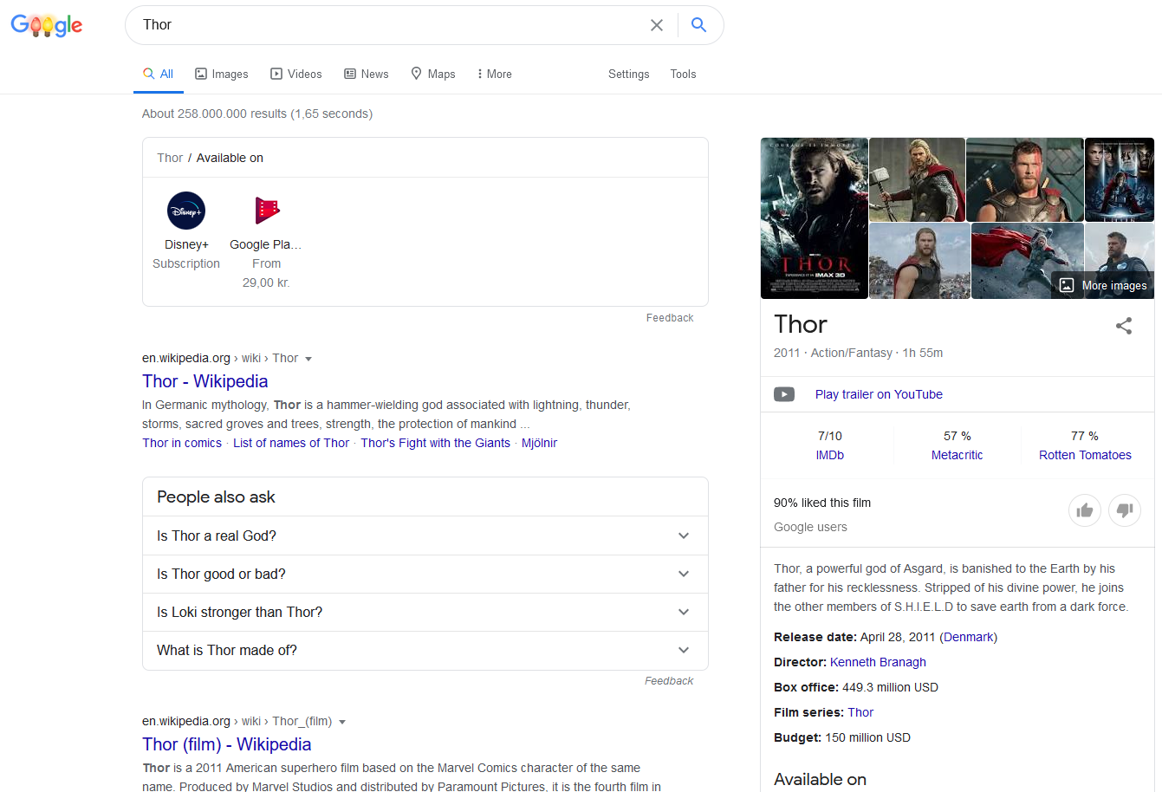
How many microservices are called?

Slide 28
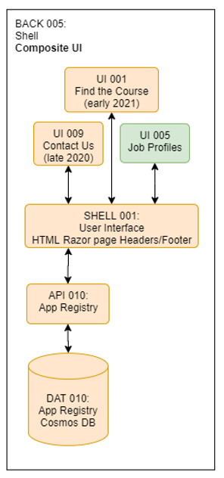
Composite UI
The composite UI design pattern has a Composite UI microservice attached which is only concerned with the design pattern
The microservice has a number of self-contained frontend views and partial views
Whenever a page is loaded, a component can request another component (a partial requests another partial)
The App Registry knows of all existing views and views that needs to be created
Via a BUS, it can then generate the necessary views to generate a view
Much like Service Discovery in Component Based software development

Slide 29
Single Page Applications
By creating frontends as single page applications, they can participate in service discovery and cache the app registry
This is the point of frameworks like Angular

Slide 30
Selecting Frameworks
Let’s do another backend/frontend comparison
In backend code, few programming languages are popular, even fewer are used for professional development – for various reasons.
Java runs on almost any hardware and OS, it has been around for decades, it is among the fastest languages to run and no other programming languages have as many fluent programmers. It provides freedom of choice for ORM, DB, IDE, Frameworks, etc.
C# has tight integration to Visual Studio, MS SQL Server (you can pick another if you want), Azure, Entity Framework, LINQ, and it runs on the worlds most popular OS’s (Windows, Linux). You don’t need to waste time choosing anything regarding platform and you have Microsoft as a single provider/vendor. Again, a ton of developers and the applications are among the fastest.
PHP has a ton of developers – not super fast or reliant, but fast to work with for web specific applications. 5 lines of code can present data from a database table in an HTML table in a view.
Python has some dedicated developers, but not as many. Very slow and not suitable for larger scale applications.
Ruby on Rails – great for web development, but not popular among developers or software vendors.
Cobol – used to be popular in finance mainframes. Today, most banks have 1 developer who knows how it works and couldn’t replace that person if they wanted to.

Slide 31
Frontend Frameworks
The browser only understands HTML, CSS, Javascript. Repeat ad nauseam!
All other languages are translated or mapped to those languages if they are not just supersets or frameworks
Somehow, there is a new favorite frontend framework every single year, and each gets a large group of dedicated followers.
So the situation from last page is much worse when it comes to frontend frameworks. Not because of the amount that exists, but because of the lack of consensus on what to use. So what should you choose?
jQuery has existed for many years and is worth learning, but probably not enough enymore, since Ecma Script can now do the same, and people started updating their browsers.
Angular, React and Vue are all great choices, but beware the number of developers in your area.
Angular is falling out of favor – it is no longer new or hyped, but I think it is the one with the largest following of developers and applications behind it. And it supports everything we discussed today.

Slide 32
Use data to select frameworks
Google Search statistics
Stackoverflow search statistics
Stackoverflow Developer Surveys
Job Postings in your area
LinkedIn capabilities in your area
Applications using the system
Benchmark speeds
Stars in GitHub
Release roadmap past and present

Slide 33
Angular
Not the same as AngularJS
Dependency Injection
Dependency Injection allows Unit Testing
Some good resources to learn more (not curriculum)
NTS: https://www.youtube.com/watch?v=VAkio68d51A
NTS 2: https://www.youtube.com/watch?v=Fdf5aTYRW0E

Slide 34
Exam

Slide 35
What happens?
Portfolio presentation 5-8 minutes (calculate 1 slide per minute)
What did you do in your project?
Select your favorite parts
How does each step relate to the curriculum?
What would/could you have done differently?
What did you learn from it?
A question is selected from the list on next slide
You answer it as it relates to your portfolio
Repeat with more questions
Exam questions are a starting point, and we will ask other related questions to guide or challenge you

Slide 36
What would be your favorite exam question?

Slide 37
Exam Questions
What is Human Computer Interaction?
What is a Design Sprint?
What is User Testing?
What is Usability Testing?
How do you design for Accessibility?
What is SEO and how do you do it?
How does the MVC design pattern work?
What is Composite UI?
What is a microservice?
What languages does a browser understand?
What is a persona?
What is a map?
What is a storyboard?
What is a prototype?
What is skeumorphism?
Explain
HTML
CSS
JavaScript
jQuery
Bootstrap
Leaflet
Google Charts
Bitmaps and Vectors
Talk about
Graphics Design
Design Guidelines and Design Systems

